Slide 1

Deep Creek Outdoors
Team B

Slide 2
Introduction - Team B
Chrys Chan - PM
Ethan Dunzer - Process Modeler
Isaac Beery - Process Modeler
Ariel Warrick - UI/UX Modeler
Christopher Barter - DBA
Tanya Eskeli - DBA

Slide 3
About Deep Creek Outdoors
What do they do?
Recreational gear supplier
Focuses on creating fishing gear
2013, stated their own small manufacturing business
Current Problems
No quality management and production tracking system
Still do a lot of things manually
Don’t keep track of inventory -> no data

Slide 4
Pain Points/Opportunities
Pain Points
Don’t have an effective way of collecting data
Don’t have a standard process
Opportunities
Easily Collect Data
Coworkers work more together
Review Returns and easier returns
Validate Goods

Slide 5
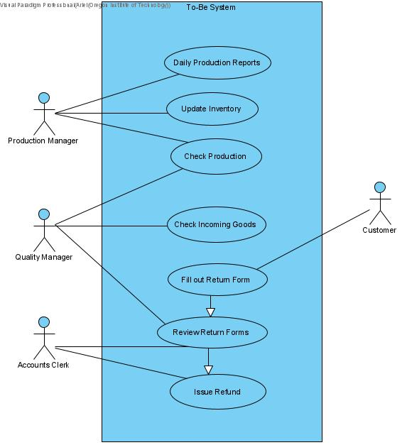
User Stories
Production Manager
Quality Manager
Accounts Clerk
Customer

Slide 6
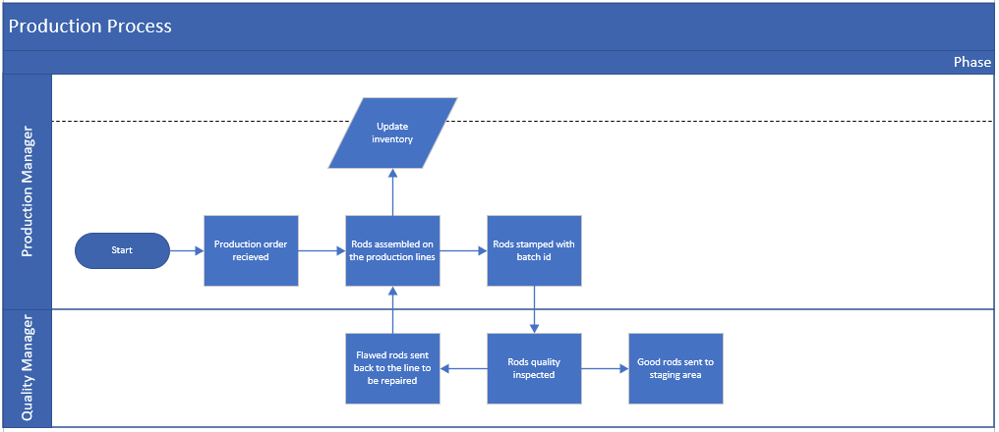
Activity Diagrams

Slide 7
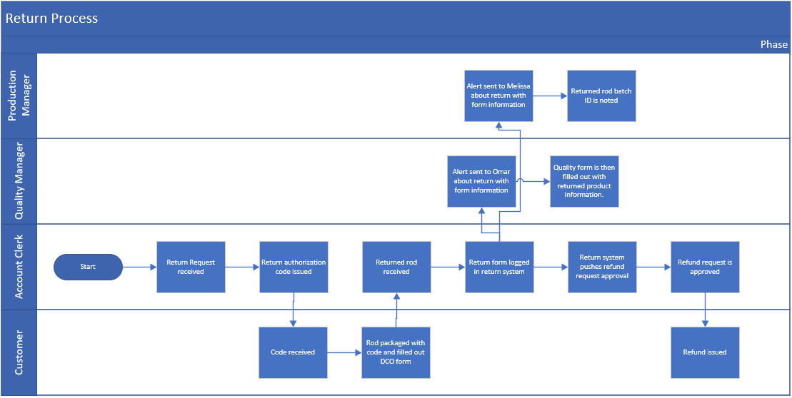
Activity Diagrams cont.

Slide 8
Database Design Concept
BEHIND THE TECH

Slide 9
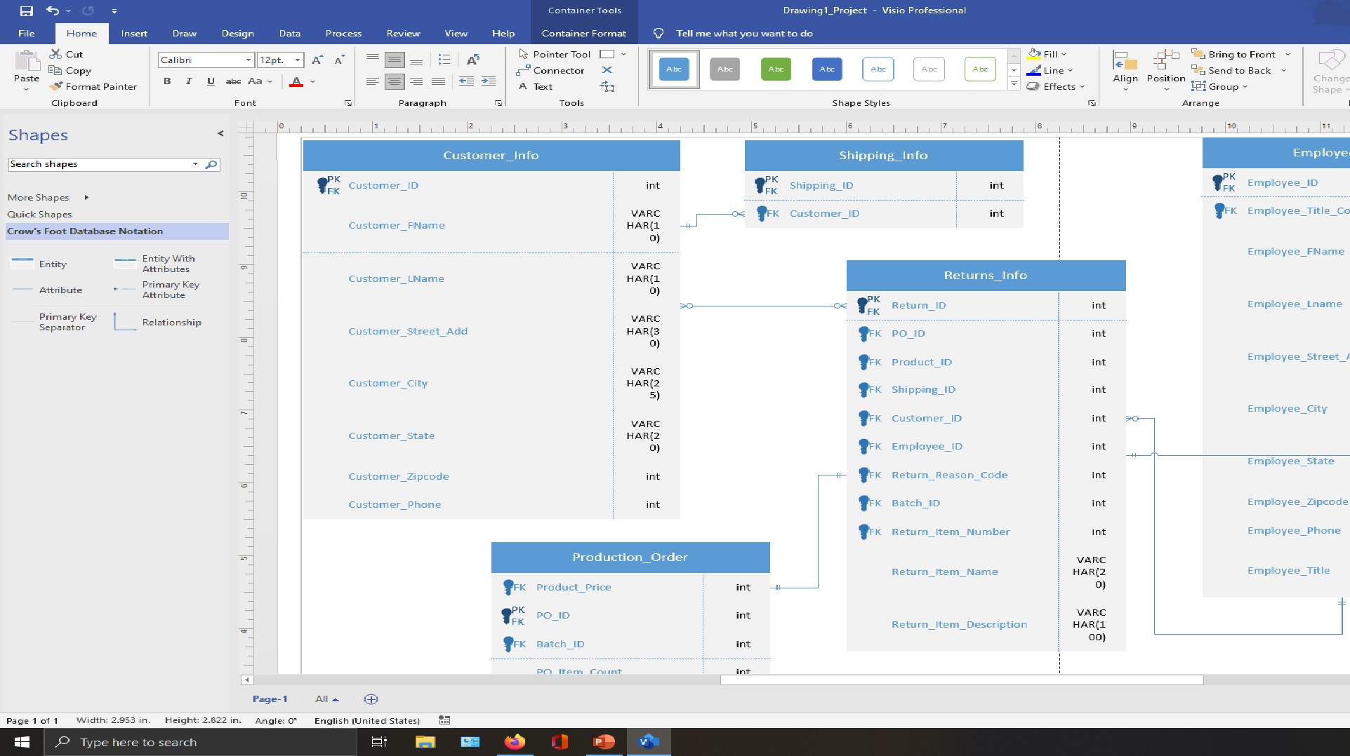

Slide 10

WW/WNWs
What’s Working?
Communications
Shared Google Drive
Meet with either Chrys or Ethan at least once a week
What’s Not Working?
PM check up on individual team member more frequently

Slide 11

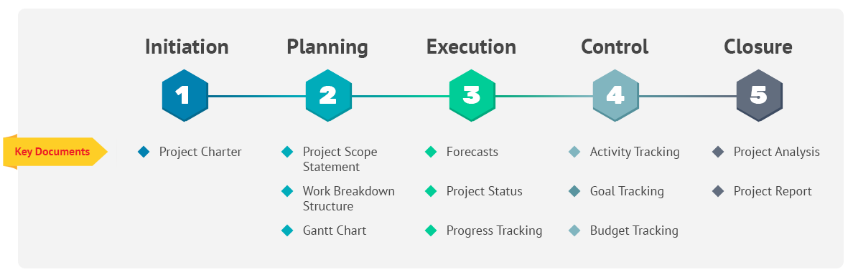
What’s Next?
Review the work that has been completed thus far.
Change workflow processes to fit the customers needs better.
Estimate cost of the project after completion.
Estimate total time of the project.
Construct the final version of the project with all information and review with the client.

